Slide 1
Current trends and challenges in the world of cycling
Fred Dotter | Mobiel 21
Project Coordinator CIVITAS ELEVATE, the CIVITAS 2020 Coordination and Support Action

Slide 2
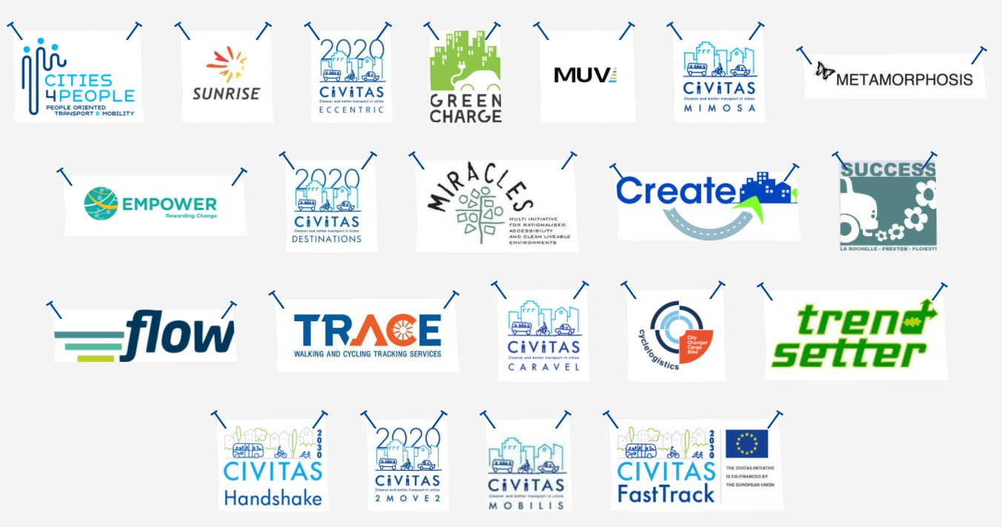





Active Mobility in CIVITAS is all about …
Making walking and cycling the preferred travel choices for people in cities!
1 of 10 Thematic Areas
3 ongoing projects
18 concluded projects
172 measures on cycling
108 measures on walking

Slide 3
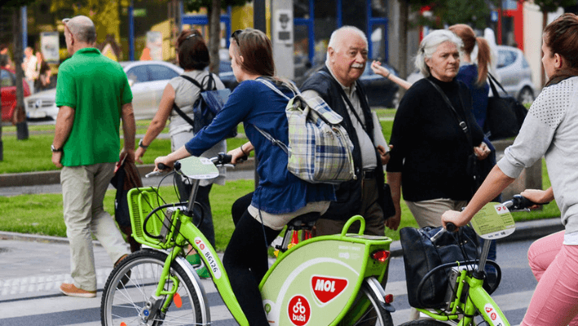
Cycling measures focus on
Integrated and inclusive planning
Shared mobility
Demand and urban space management
Behavioural change and Mobility Management
Clean and energy-efficient vehicles
Public participation and co-creation
Road safety and security
Urban logistics
Check the CIVITAS website
civitas.eu/mobility-solutions

Slide 4
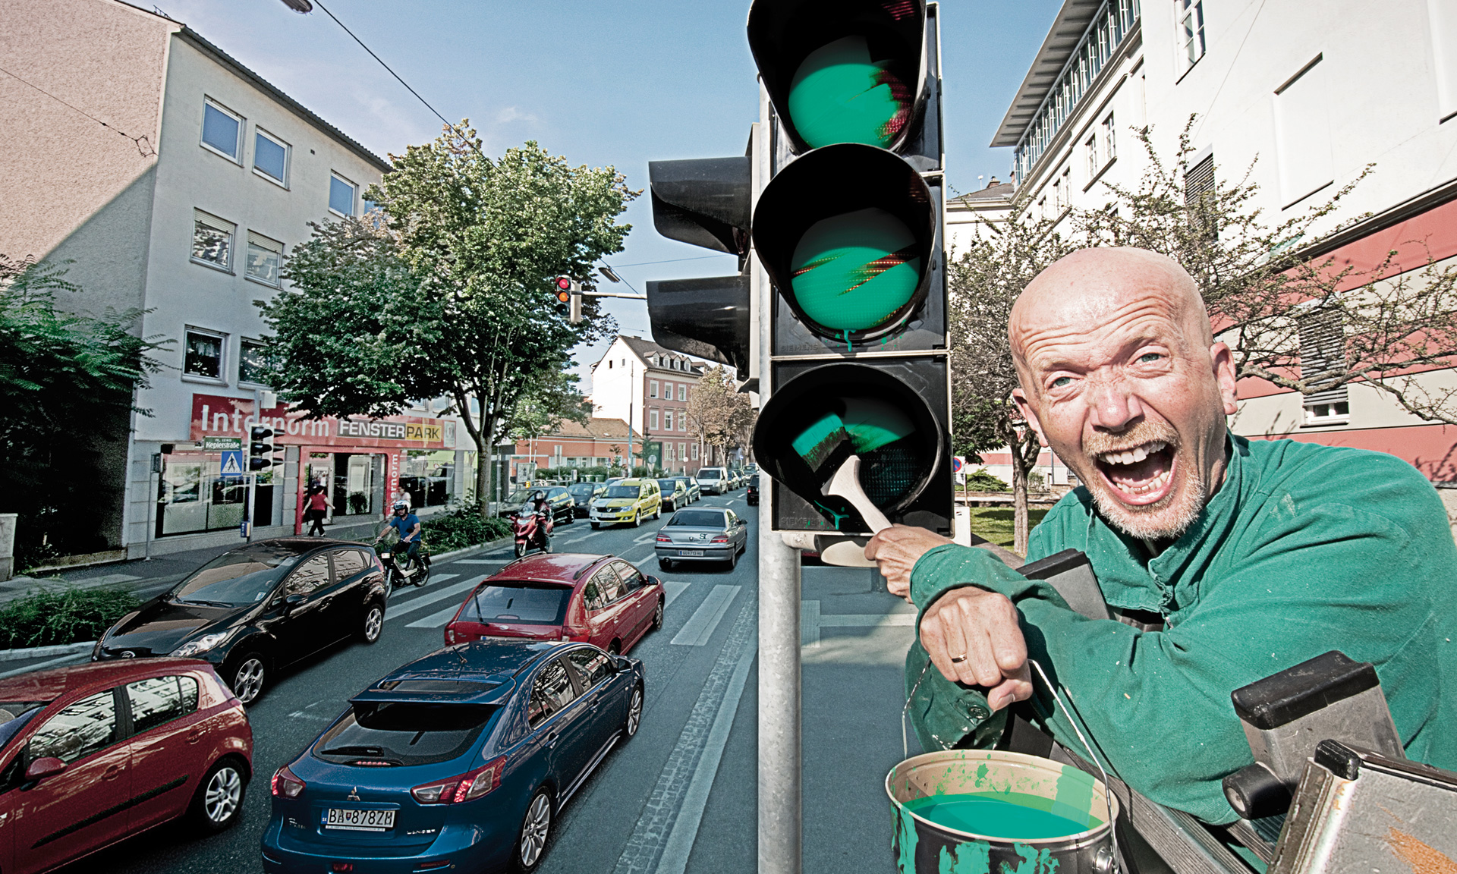
Myth I
“We don’t have money for bike infrastructure, but a little painting would do as well.”

Slide 5
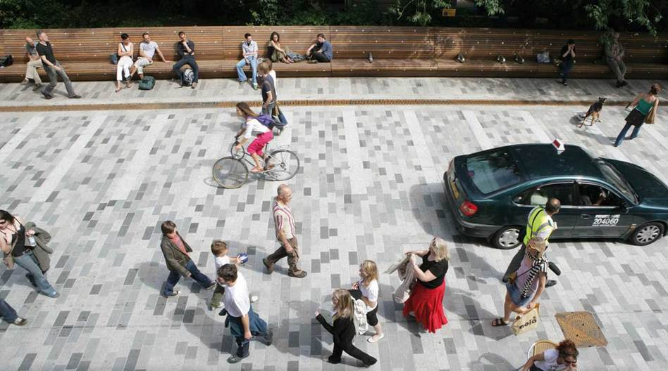
Safer road infrastructure
New kinds of cycling infrastructure or approaches to encourage cycling must be assessed carefully to avoid adding to problems they are designed to correct.

Slide 6
Cycling has to be more attractive to encourage people to use their bikes. Perceived lack of safety is often cited as a major barrier. Improving road safety and increasing comfort and accessibility is a way to make it a more appealing option.
More focus on cycling in sustainable urban mobility planning is needed!
Cities and companies have to innovate in cycling!
High speed cycling needs to be taken into account!
Combining different domains of land use is needed!
Recognise the importance of getting investment right!

Slide 7
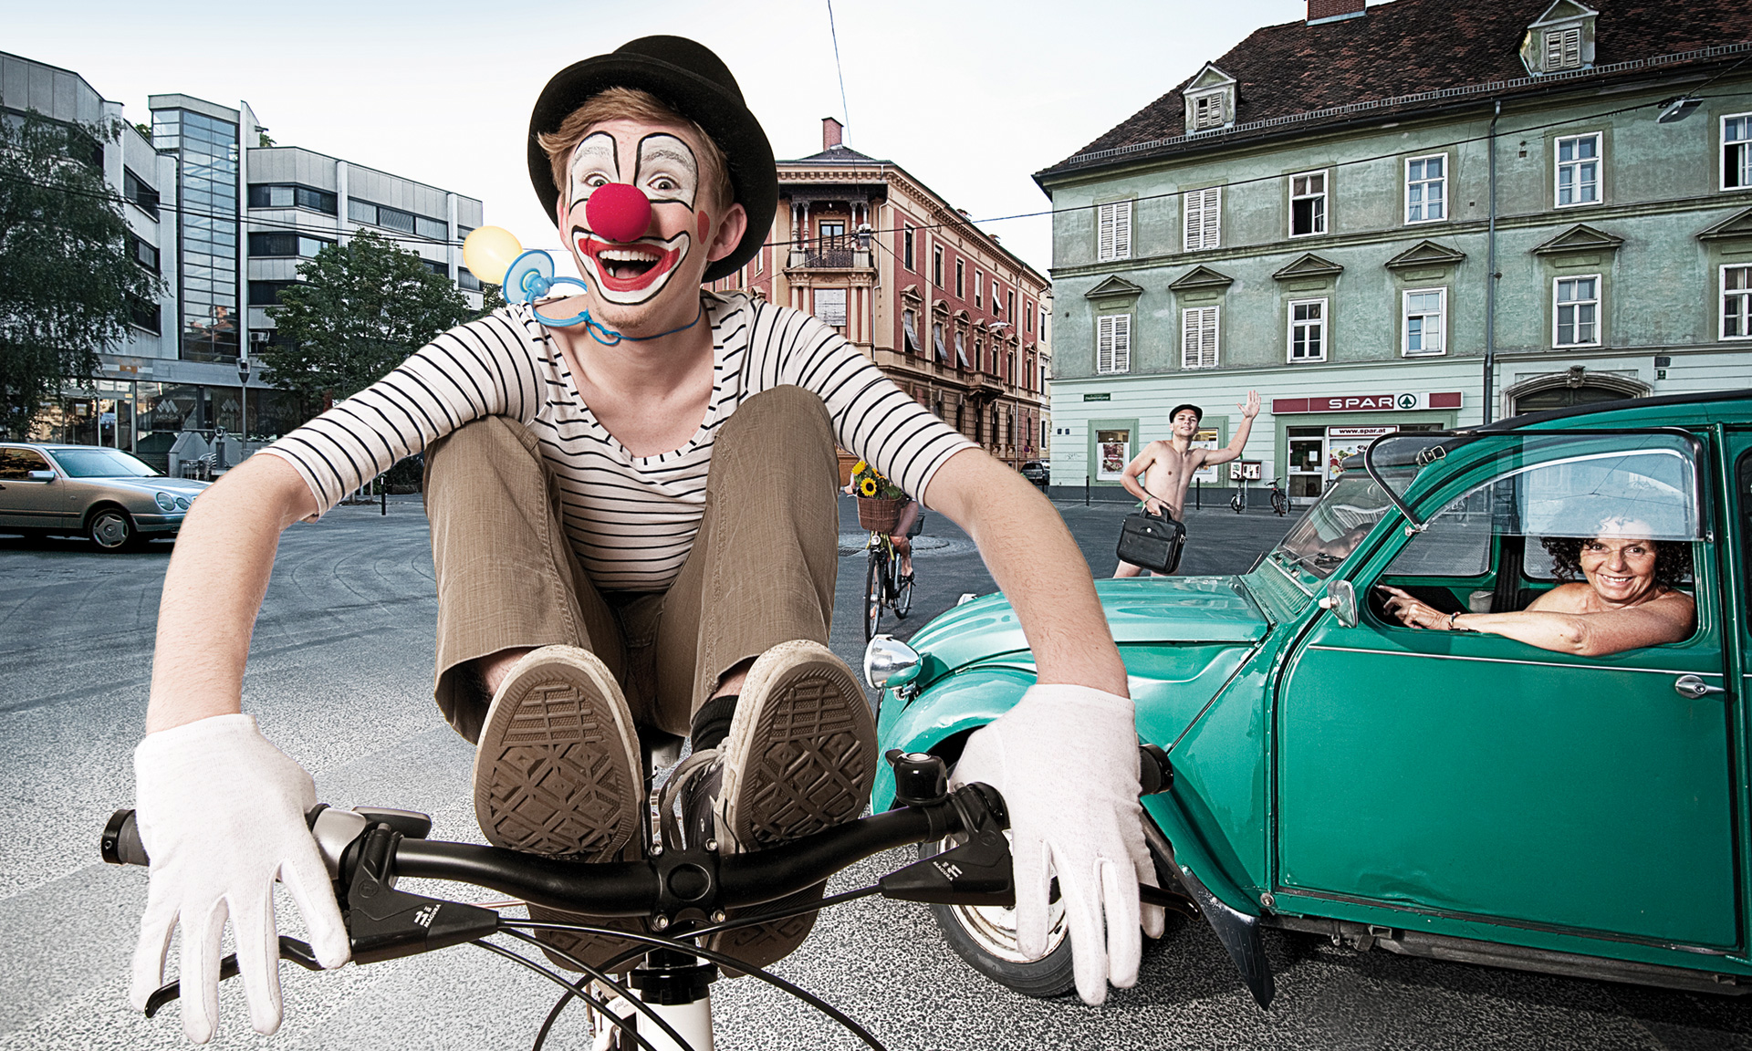
Myth II
“We don’t need a bike sharing system, because in my city, everyone has a bike.”

Slide 8
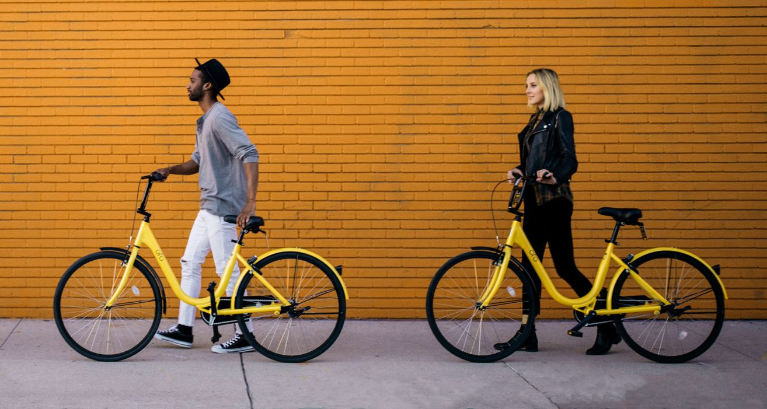
Bike sharing as a link to desired destinations
Introduced to increase the mobility choice, improve air quality and reduce congestion. The basic premise of the bike sharing concept is sustainable transportation.

Slide 9
Bike sharing has a key role to play as part of sustainable and smart urban transport networks. It provides a complementary transport offer to buses, trains and trams and generates multiple benefits.
It enables a modal shift from cars!
It helps to make the city more attractive to visitors!
It helps to improve accessibility across all social groups!
It helps to improve residents’ quality of life and health!
It creates local jobs for the installation and operation of the schemes!

Slide 10
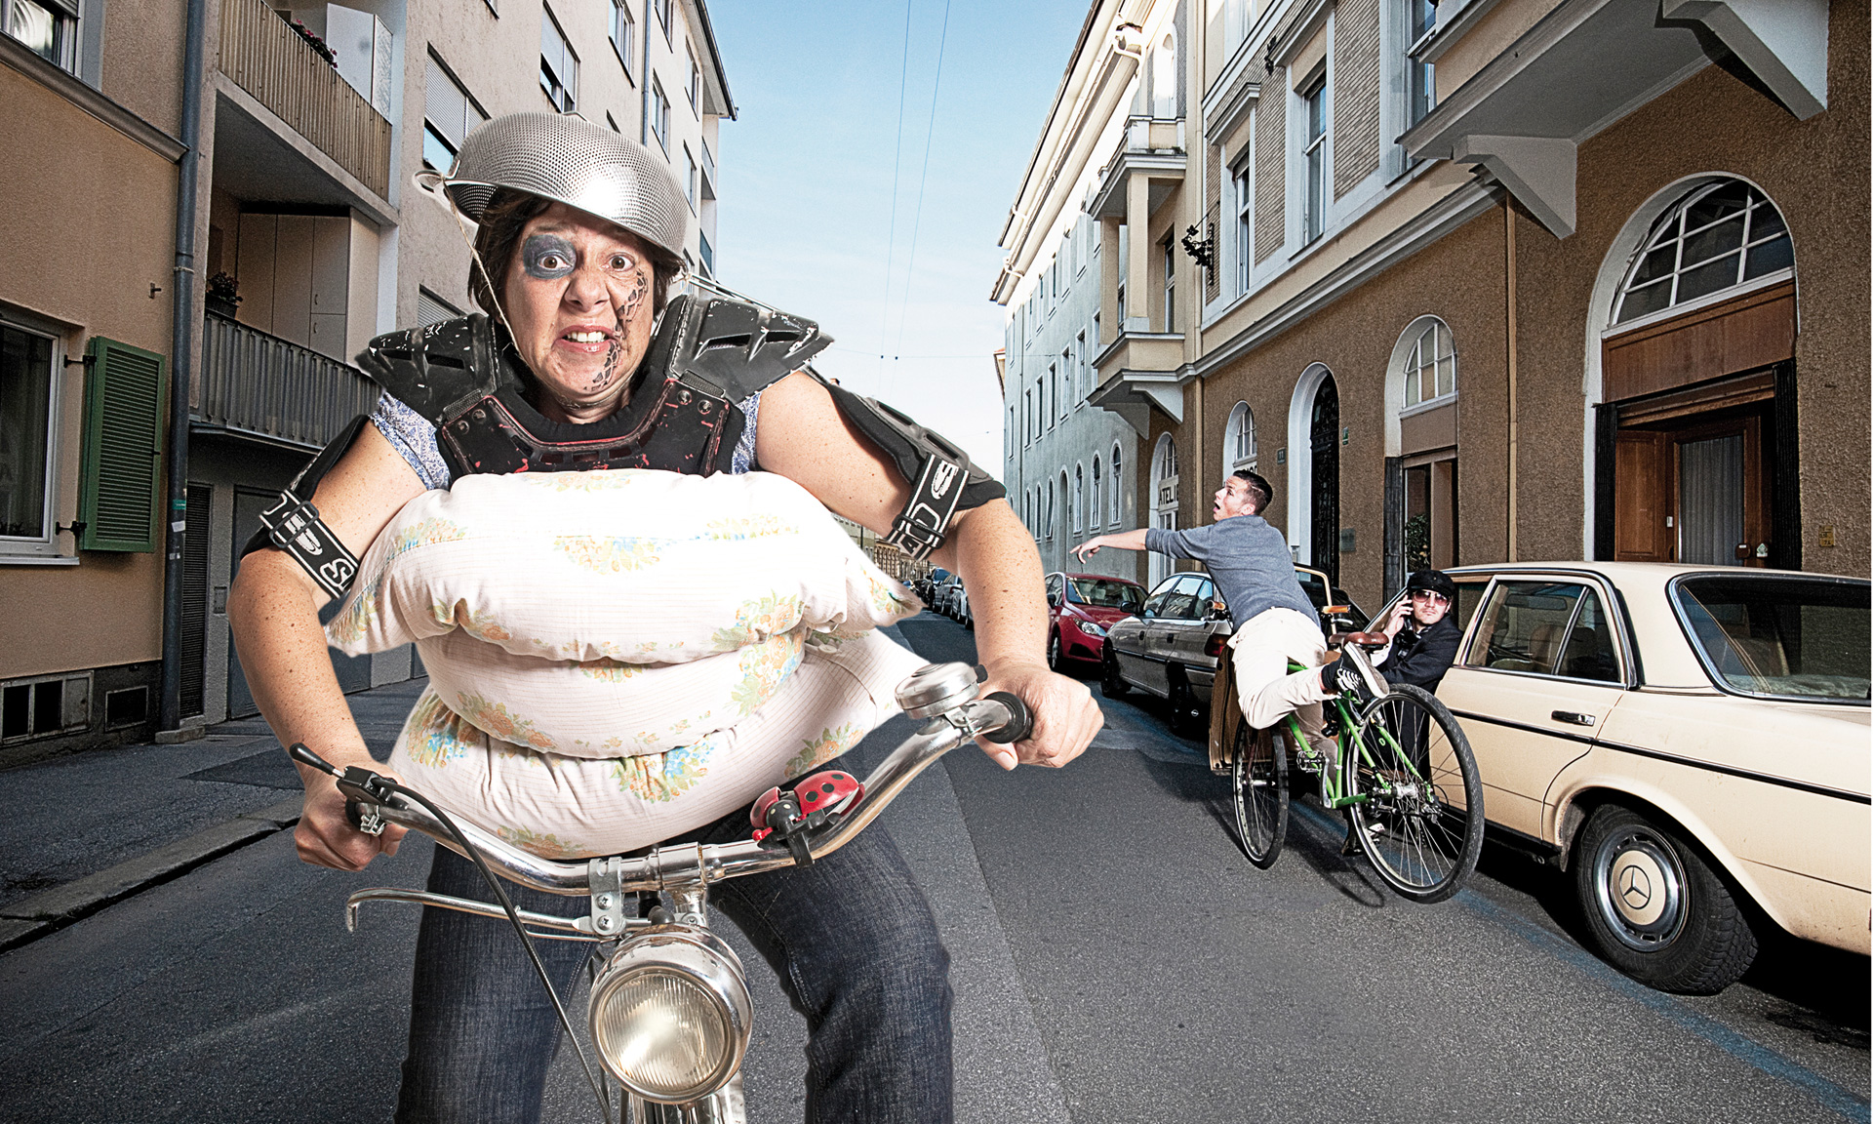
Myth III
“I drive my children to school, because it is too dangerous for them to walk or cycle because of all the cars on the street!”

Slide 11
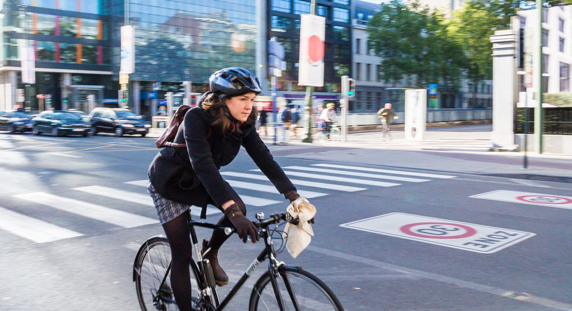
Planning for sustainable travel
Developing and implementing a travel plan to foster commuting by bike can reduce the need for people to travel to and from a location by car and encourage others to travel more sustainably.

Slide 12
The concept works by developing balanced packages of user-focused transport tools in a partnership that seeks to provide meaningful benefits to each of the stakeholders involved.
Commuting by bike is not an instrument but a strategy!
It should be supported by the organisation and by the government!
It seeks to deliver related benefits to the community!
It is very site-specific and tailored to the specific circumstances!
It should be supported by a wide variety of transport instruments!

Slide 13
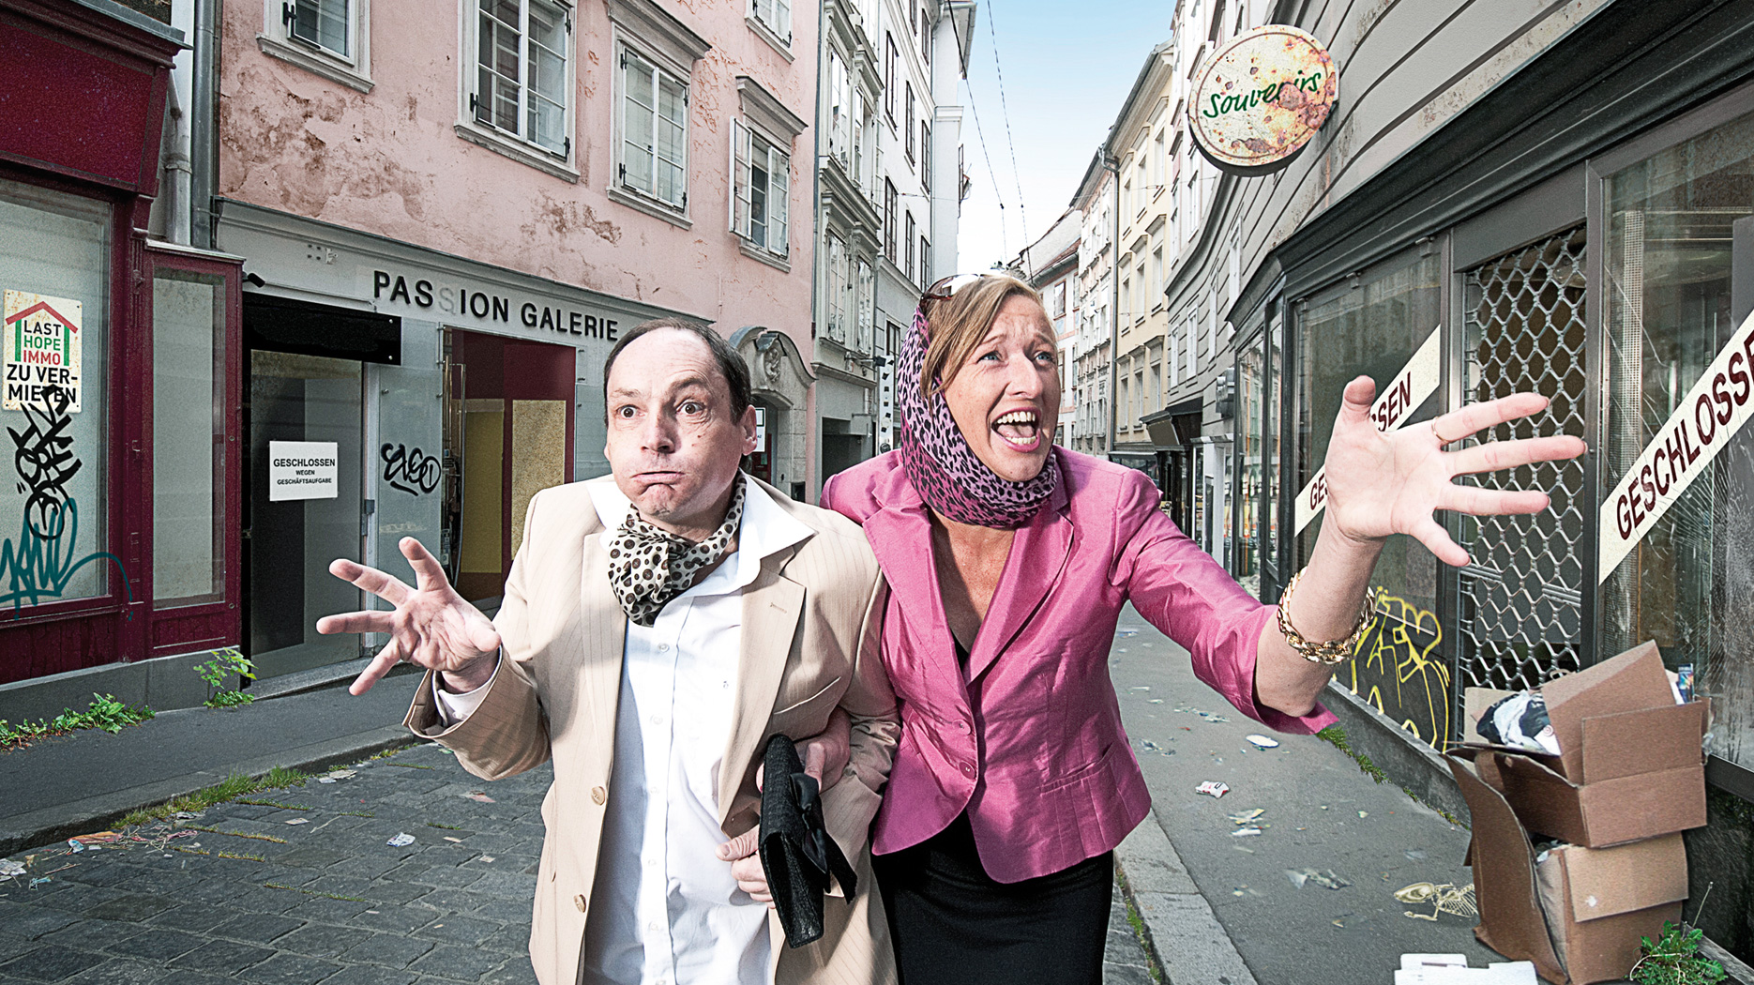
Myth IV
“If I would ban all the cars, the city centre will die.”

Slide 14
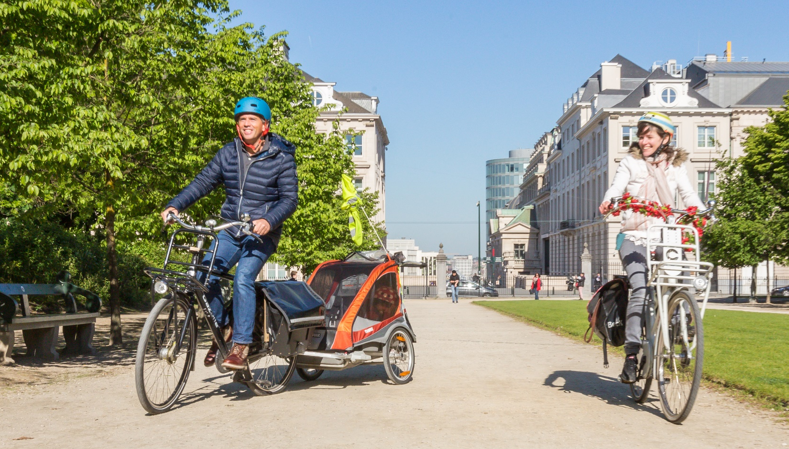
Delivering the desired cycling change
  Cities are complex systems requiring complementary skills. Cycling is a powerful way to steer cities towards being more sustainable, equitable and economically prosperous.

Slide 15
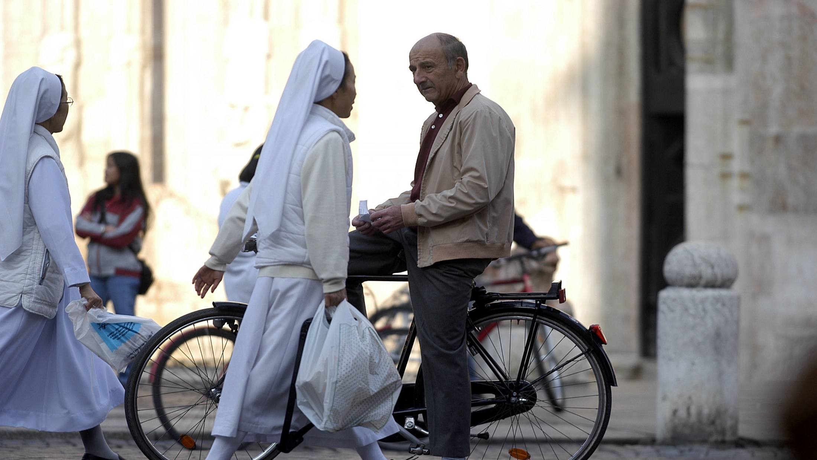
Let’s share and inspire excellence!
Commitment, courage, vision, innovation and leadership considerably impact the outcome and often separate success from failure.

Slide 16

Because we all want more of this …

Slide 17

… and less of this!

Slide 18




Thank you for your kind attention!
Stay connected and
Follow us on social media
Subscribe to our newsletter civitas.eu/newsletters
Get in contact with us secretariat@civitas.eu
civitas.eu
Fred Dotter | Project Coordinator CIVITAS ELEVATE
Mobiel 21 | Director European Projects and Policies
Vital Decosterstraat 67A/0101 - 3000 Leuven, Belgium
fred.dotter@mobiel21.be | www.mobiel21.be
This presentation has been produced by CIVITAS ELEVATE, a CIVITAS Coordination & Support Action. The CIVITAS ELEVATE project has received funding from the European Union’s Horizon 2020 research and innovation programme under grant agreement No. 824228.
Images used in this presentation: ©Mobiel 21, ©Stadt Graz, ©Stadt Wien, ©unterwegsinberlin.de

