Slide 1
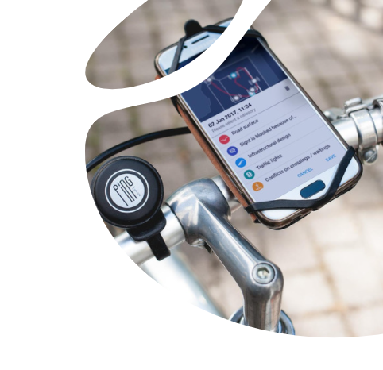

PING
Upgrade your cycling city
Campaign by
App Technology by

Slide 2
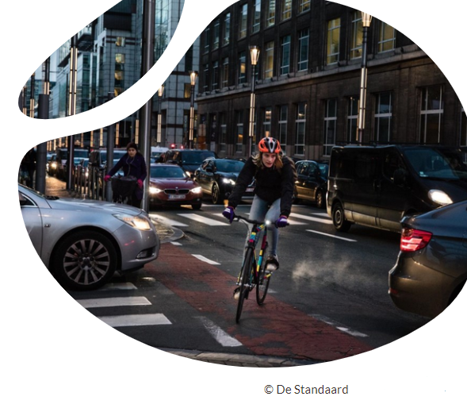
The problem

Slide 3
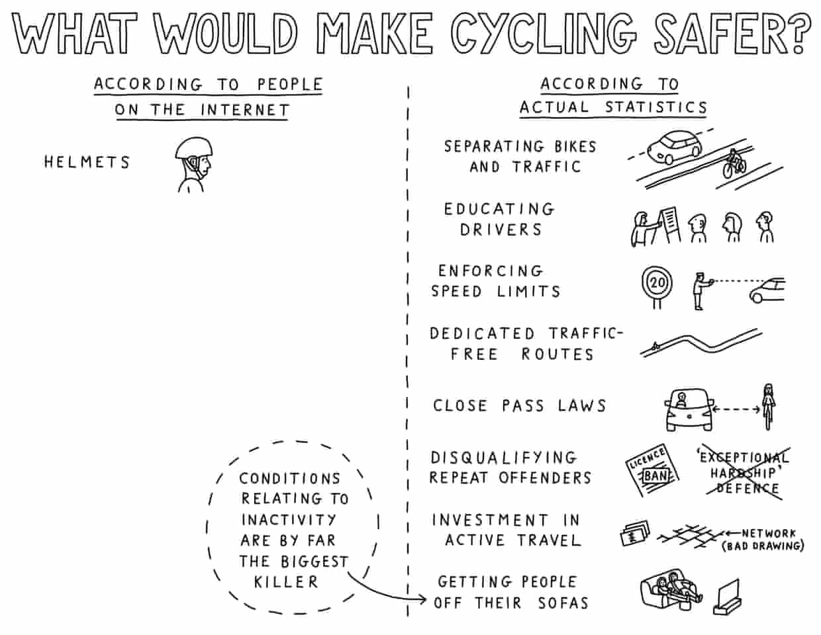
The challenge
© Davewalker_CT
©Mobiel 21 ©Bike Citizens

Slide 4
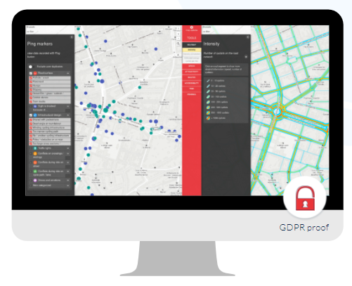
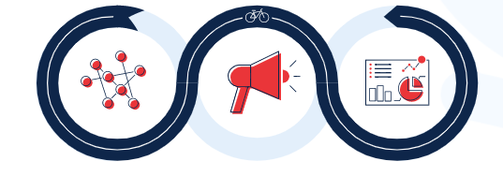

The solution
©Mobiel 21 ©Bike Citizens

Slide 5
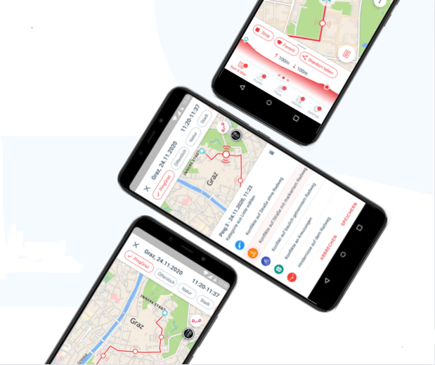
PING if you care!
Simple - An app, a button, a list, an analytic tool.
Quick - Mark a location. Leave a comment.
Universal – Instinctively, by the natural impulse.
©GETTY

Slide 6
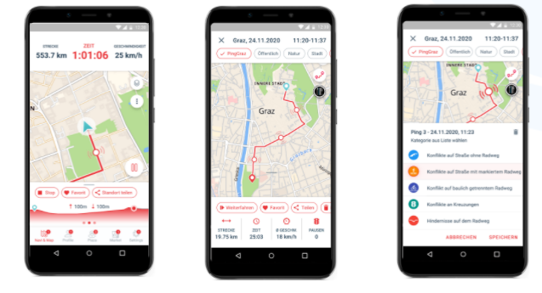
Easy to use
in just 3 steps: track, Ping, comment.

Slide 7
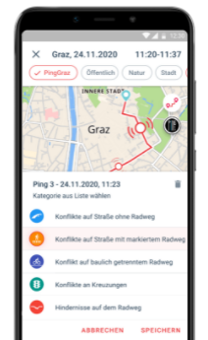
PING data
3 categories of data:
Route Data | Tracks
PING data (geolocated & categorised data)
Demographic data
GDPR proof | anonymised
Connect categories
Analytic tool

Slide 8
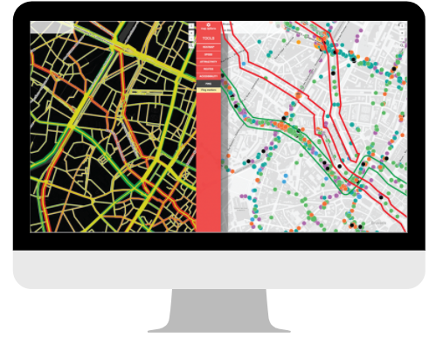
PING analyses and correlates
©Mobiel 21 ©Bike Citizens

Slide 9
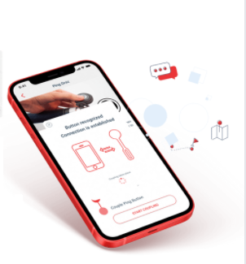
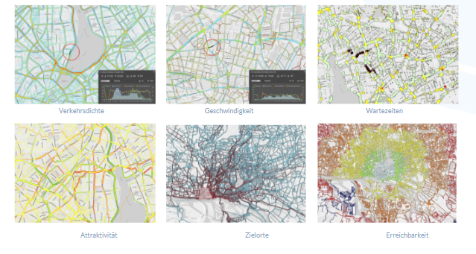
PING helps to make it better!
©Mobiel 21 ©Bike Citizens

Slide 10
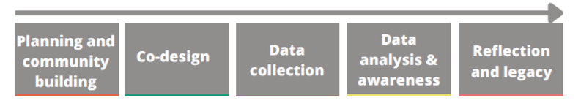
PING & Citizen Science
Cyclist are involved in all research and policy making steps:

Slide 11
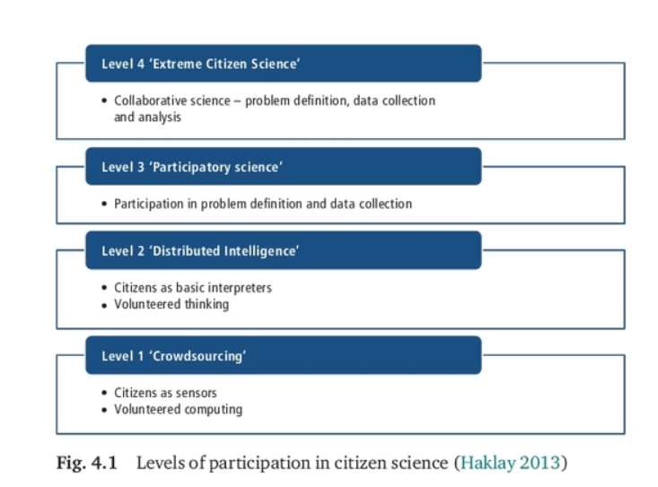
PING & Citizen Science
Citizen science: an umbrella term describing a variety of ways in which the public participates in science.
Participation is the distinguishing element between citizen science and public engagement in science
→ Levels of participation
→ Who participates depends on what is expected of them

Slide 12
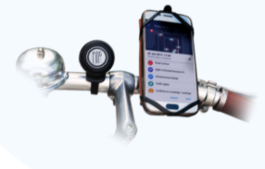
Advantages of Citizen Science (in cycling policy)
more participation in research and policy making
research on a larger scale
new sources of information, knowledge and perspectives
stronger links between citizens, scientists and policy makers
development of new methods
improving the openness of, reliability of and support for of research and policy making
Scientists, knowledge institutions and policy makers understand (better) current issues in society
focus research on citizens' priorities

Slide 13
PING & Citizen Science
How do you approach this citizen science project, focusing on the right level of participation?
https://we-count.net/deliverables

Slide 14
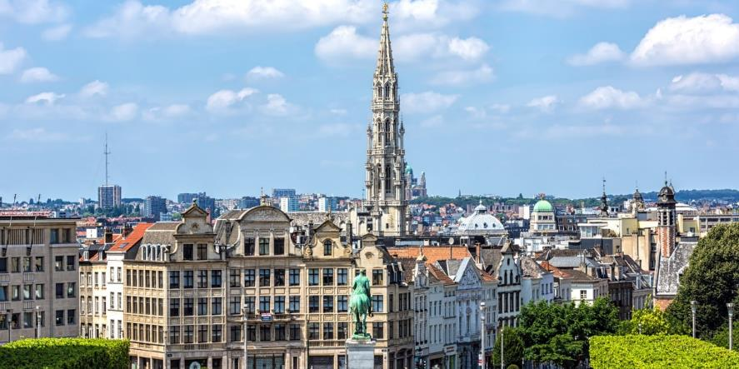
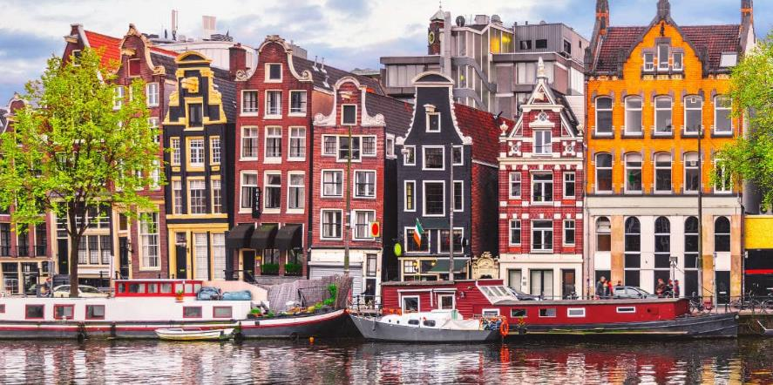
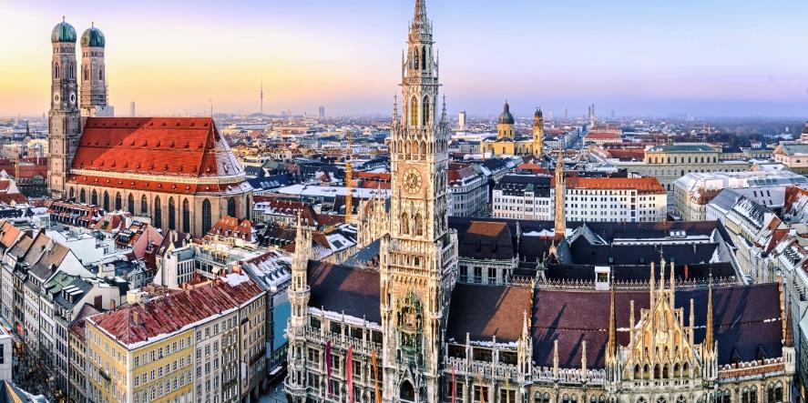
Brussels | June 2017 – January 2018
Amsterdam | March 2019
Lisboa |
Munich | September 2019 – October 2019

Slide 15
PING Data | PING research in Brussels
What makes cycling in Brussels unsafe according to Brussels cyclists?
What are hotspots for cyclists in Brussels? What is the cause of making these places a hotspot?
Are different target groups sensitive to various problems regarding bicycle safety?
How does the feeling of insecurity in cycling in Brussels vary according to different times of the day?

Slide 16
PING Data | What makes cycling in Brussels unsafe according to Brussels cyclists?
Category | PINGS | Participants
Infrastructural design | 18% | 60%
Road Surface | 32% | 54%
Conflicts during ride on street | 16% | 54%
Conflicts on crossings / waitings | 7% | 53%
Conflicts during ride on cycle path / lane | 18% | 50%
Stress and emotions | 3% | 32%
Sight is blocked because of… | 5% | 25%
Traffic lights | 2% | 23%
Infrastructural design: The absence of or unclear cycling infrastructure, poles and obstacles, too large intersections; too narrow cycle paths, shared infrastructure with pedestrians
Conflicts: a parked car on the cycle lane, car drivers who give too little space to cyclists, tailgating, ...
Stress and emotion: Almost-accidents, cases of road rage, dooring…

Slide 17
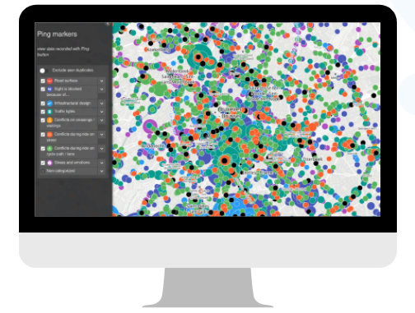
PING Data | What are hotspots for cyclists in Brussels?
Zoom in per main category (8)
  Road surface
  Sight is blocked because of…
  Infrastructural design
  Traffic lights
  Conflicts on crossings / waitings
  Conflicts during ride on street
  Conflicts during ride on cycle path / lane
  Stress and emotions

Slide 18
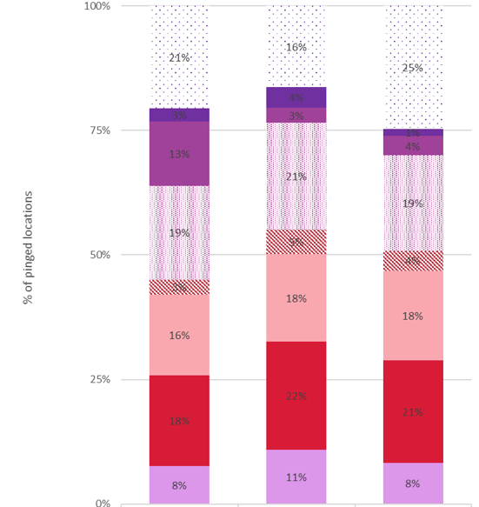
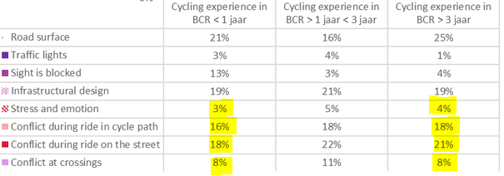
PING Data | Different target groups, different safety issues in Brussels?
1
2
3
1
2
3

Slide 19
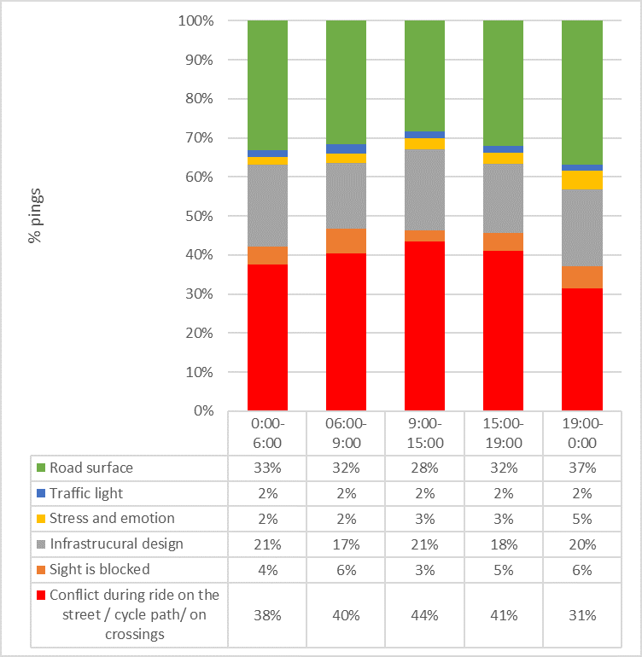
PING Data | Different time of the day, different safety issues in Brussels?

Slide 20
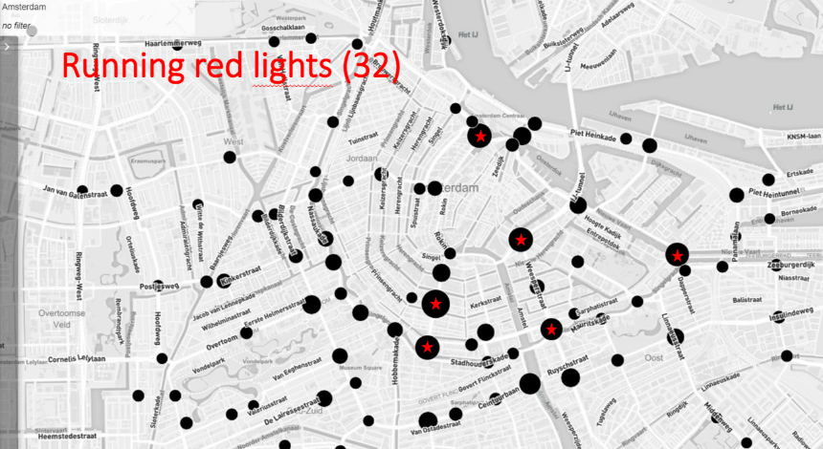
PING Impact | PING issues tackled in Amsterdam
Reported | Solution
delay because of long waiting time | better alignment of traffic lights | 6 locations
Bad surface | Road improvement | 5 locations
Cyclists as counter-traffic | redesign, extra bicycle crossing | 3 locations

Slide 21
PINGifyoucare.eu
PING@mobiel21.be
Campaign by
App Technology by

